Slide 1
QuantConnect Alpha Strategy
Bringing algo-trading closer to non-professional investors
Group 3A

Slide 2
Agenda
01
Trading Strategy as a Product
02
Understanding Our Client
03
QuantConnect Alpha Market
04
Our Solution and comparison
05
Revenues & Costs

Slide 3
1.Trading Strategy as a Product

Slide 4
New Way of Trading/Investing
Professional trading/investment
QuantConnect
Alpha Market
Personal trading/investment
QuantConnect is a platform for :
Algo-Trading;
Analytics/Research;
Trading strategy marketplace.

Slide 5
Roadmap
Python
QuantConnect
Refine trading strategies
Trading
Proprietary
Capital
(Income Source 2)
1
3
5
2
4
6
Development of long and short term trading strategy
Submit on Alpha Stream
(Income Source 1)
Fund Management
Business
(Income Source 3)

Slide 6
2.Understanding our client

Slide 7
Our Client
The persona :
reached legal age to open trading account.
generally, not savvy traders or investors.
aware what are stocks or shares markets about.
looking to invest idle fund to generate risk adjusted returns from trading, at least beating inflation rate.
looking to invest in liquid assets classes or financial instruments using strategies which can be repeated over time to generate returns.
looking for strategies which emphasize capital appreciation & growth

Slide 8
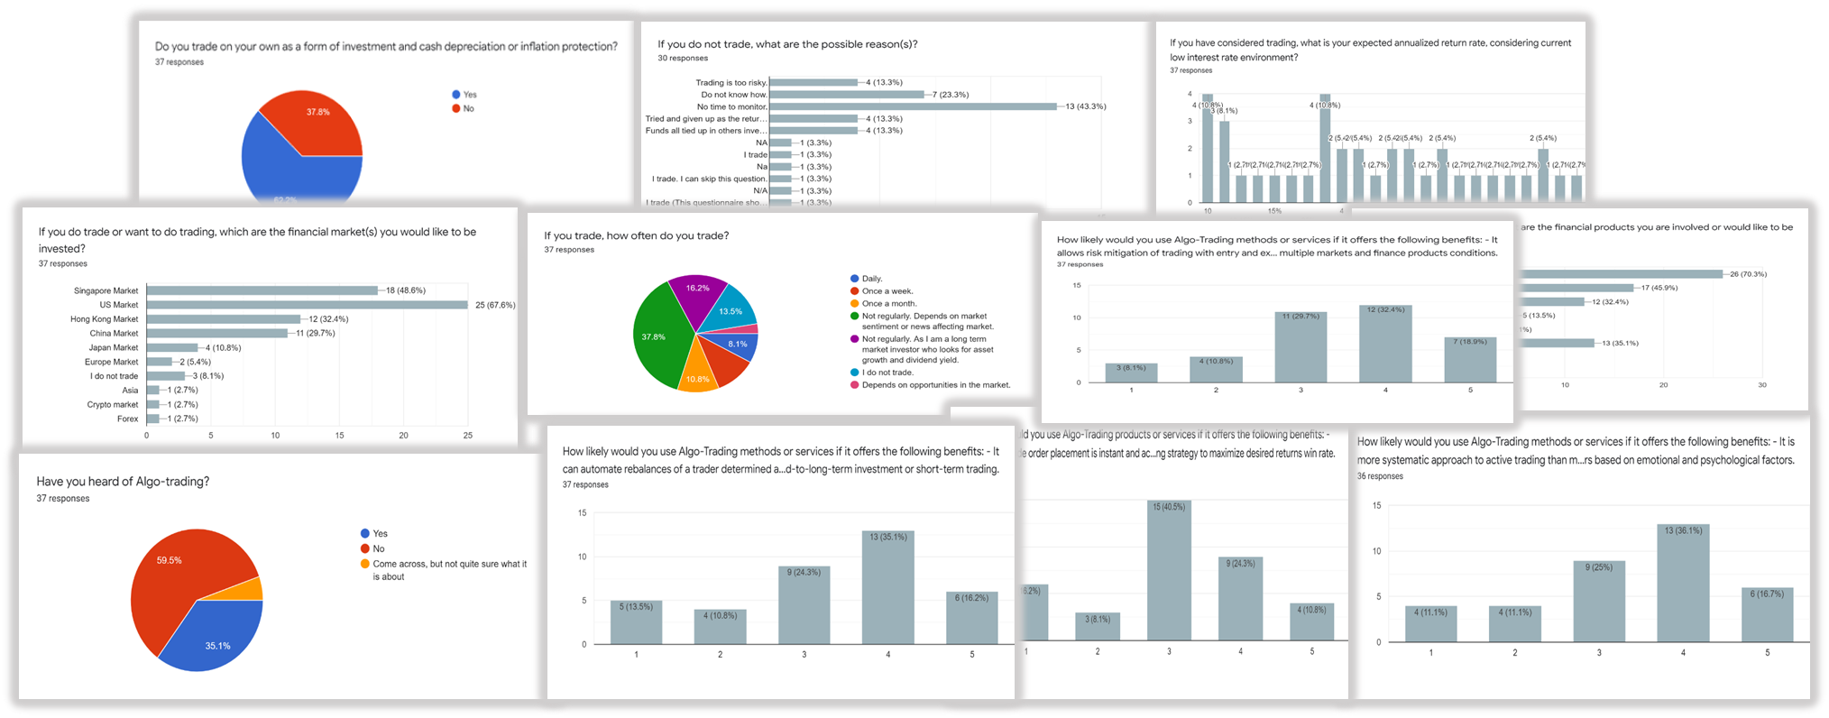
Survey Questionnaires
Total 37 responses are obtained.

Slide 9
Understanding Our Client
From survey:
about 62%, does trading as a form of investment inflation protection.
most cited reason for not trading or actively involved in trading is lack of time to monitor trades.
68%, expected to achieve an annualized return of 3% to 10%, with 18% expecting above 10% to 20% return.
68%, has shown interest in US market for trading.
instruments of interest :- 1) Equities, 2) ETFs, 3) Crypto-currencies 4) REITs
Only about 35% knows about Algo-trading.

Slide 10
Survey Insights
time for monitoring markets as main factor for not involved in trading or engage in it frequently.
expected annualized return rate at least 3% to 10%.
shown high interest in US market, which offered relatively most liquid and choices of trading instruments.
most does not know about algo-trading, about half is likely to engage in one, when told of its benefits, in particular:
allow systematic approach to active trading than methods based on individual’s intuition or instinct.
reduce possibility of human mistakes in trading based on emotional and psychological factors.

Slide 11
Further Insights
All were willing to pay at least $3 -$5 per month?
Probing with 4 personas with algo-trading knowledge:
preferred minimum subscription fee allowed in Quant-Connect platform, i.e. USD 3 per month.
expected annualized return rate - 5% to 10%.
strategy to execute at least once a week or a month.
concern about strategy’s capability and effectiveness in meeting profitability target.
options of types of instruments based on risk appetite.
to know instruments’ measure of volatility, back-tested Sharpe ratio and absolute returns.
strategy that would consider time & volume weighted average price.
Which is preferred week or month?

Slide 12
3. QuantConnect Alpha Market
A typical case of strategy selection

Slide 13
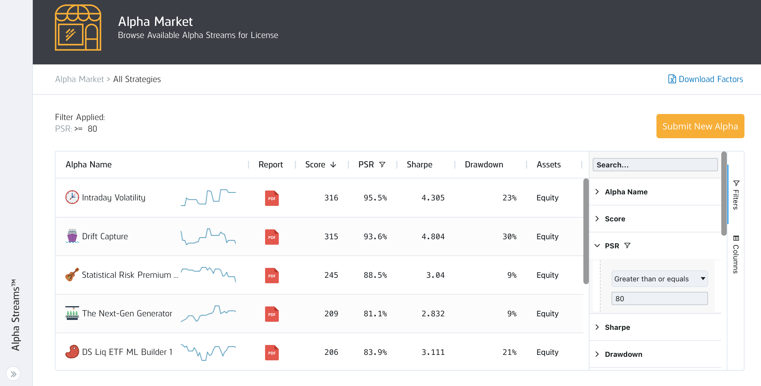
Strategy selection on Alpha Market

Slide 14
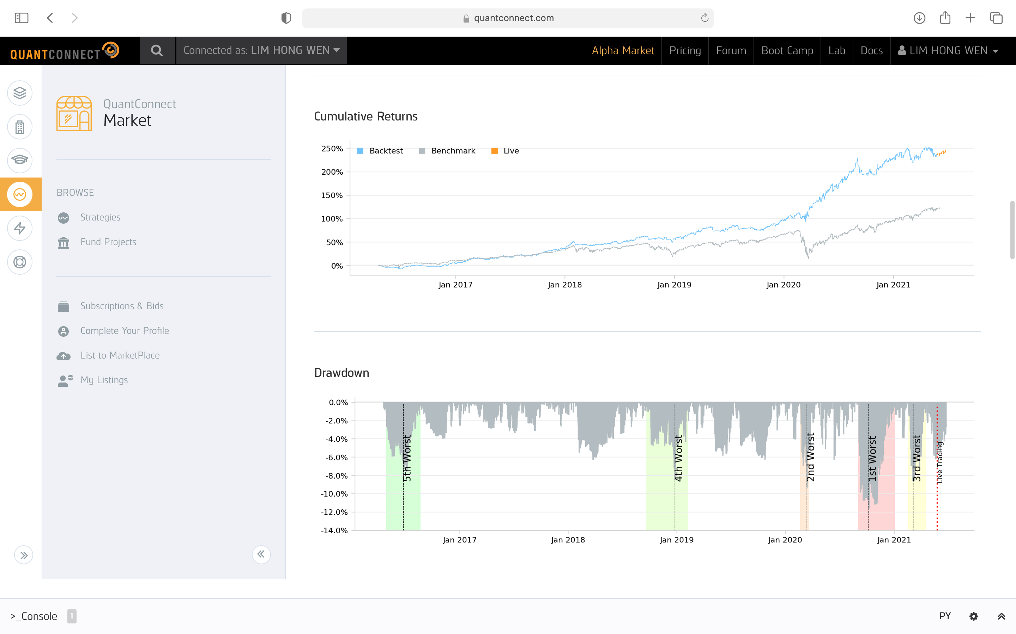
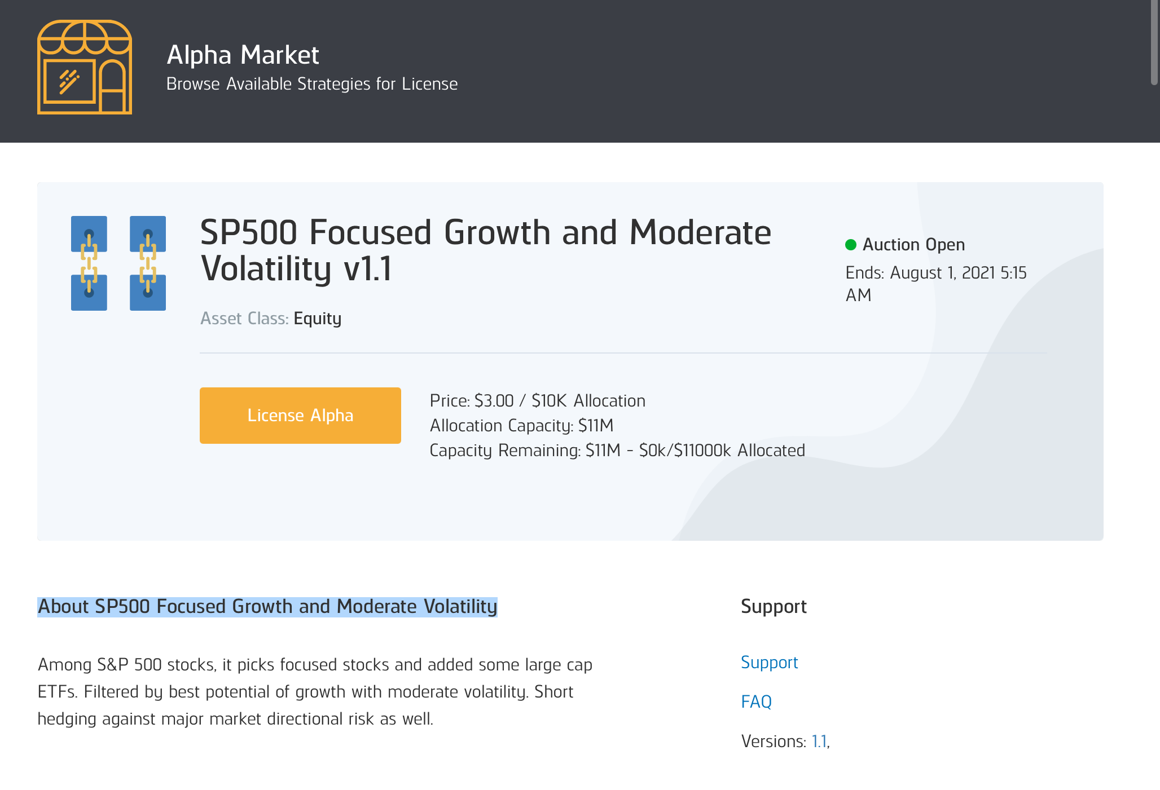
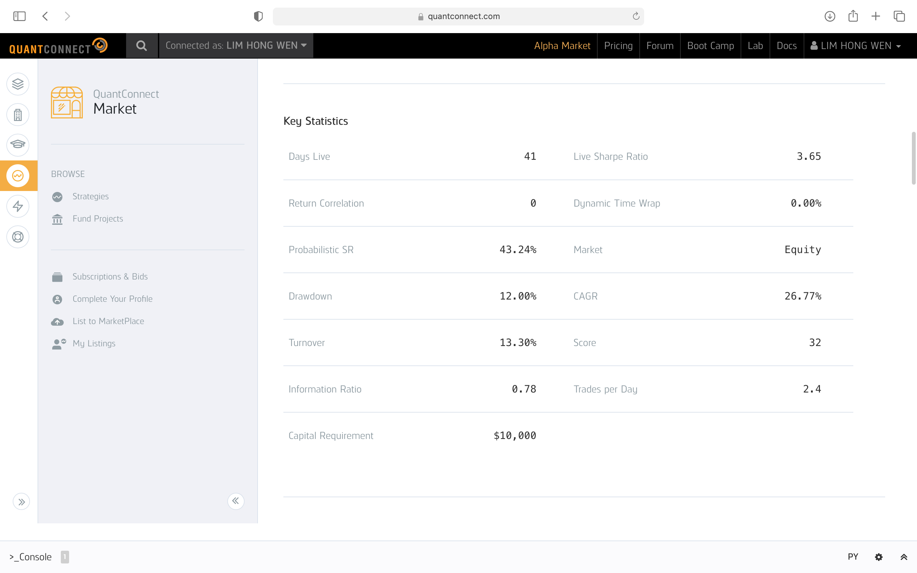
Example of a strategy

Slide 15
4. Our Solution and comparison

Slide 16
Existing investment methods
 | Pros | Cons
Wealth Management | Least efforts | High fees, Control, Visibility
Mutual Funds | Availability | Enter/exit process, Regulatory limitations
Hedge Funds | Access to wider range of strategies and markets | Low availability, High fees, Control, Visibility
ETF | Low fees | Passive strategy only
Manual trading via a broker or directly | Availability, Control, Visibility, Fees | High complexity, requires expertise
Robotraders/Theme investments | Combines positive sides of other investment methods | Still requires “trusting” your funds to a third party

Slide 17
Our solution
Advantages compare to existing trading/investments methods:
Competitive performance
Our strategy consists of short-term trading strategy and long-term investment strategy, providing good balance between risk and return
Availability
Publicly available on QuantConnect Alpha Market (within capacity limit)
Visibility and control
All stats (back-testing and live) are available; plus clients can exit from the strategy whenever they want
Low fees
Clients pay to QuantConnect for providing deployment space for the strategy (44 $/month) and there is a fixed fee for the strategy use (3-10 $/month).
Trust

Slide 18
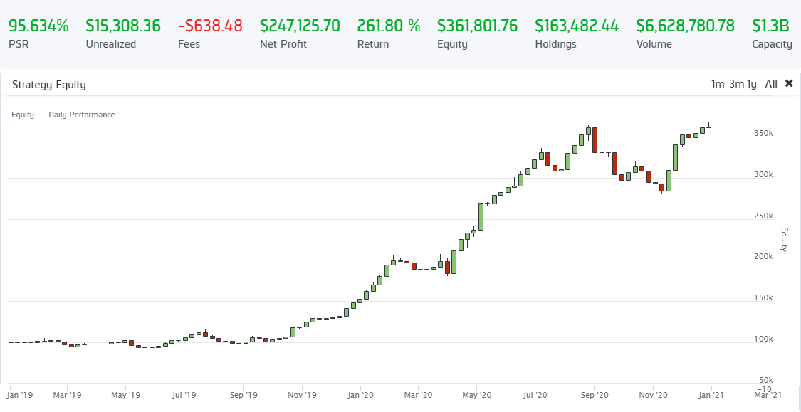
Trading strategy back-testing

Slide 19
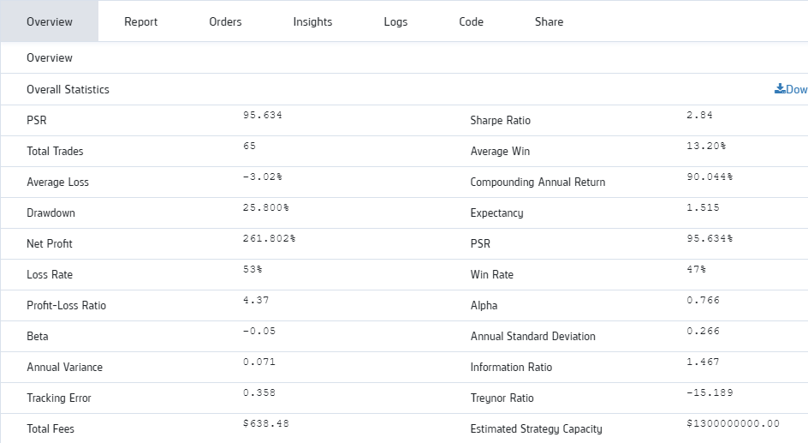
Trading strategy stats

Slide 20
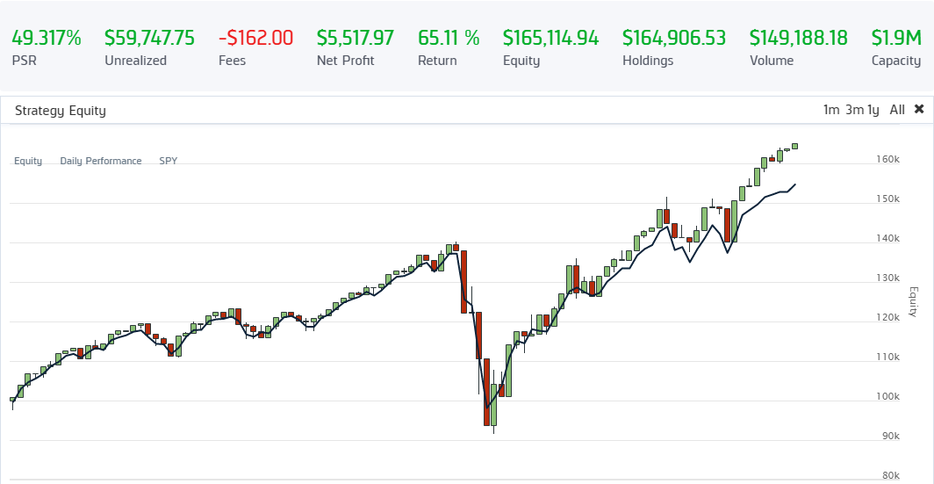
Long-term strategy back-testing
Passive implementation of S& P 500 using ETFs

Slide 21
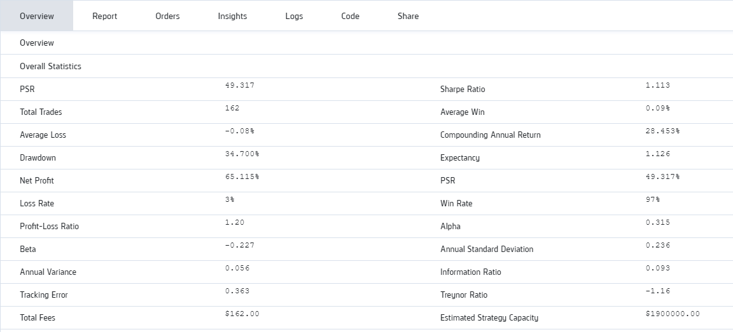
Long-term strategy stats

Slide 22
5. Financials

Slide 23
Financials
Revenue Assumptions
Licensing fee @$3 per month or $36pa per strategy per client.
Yr 1
Average of 3 strategies with 10 clients each.
Yr 2:
Another 3 strategies added. Total of 6 strategies with an average of 20 clients each.
Yr3
Another 3 strategies added. Total of 9 strategies with an average of 30 clients each
Proprietary trading @20% on $50,000 = $10,000 per annum

Slide 24
Q & A
Any questions?

